Slide 1

ISAD254SL Human Computer Interaction​ ​
N.N.D.G. Liyanage
10707256

Slide 2
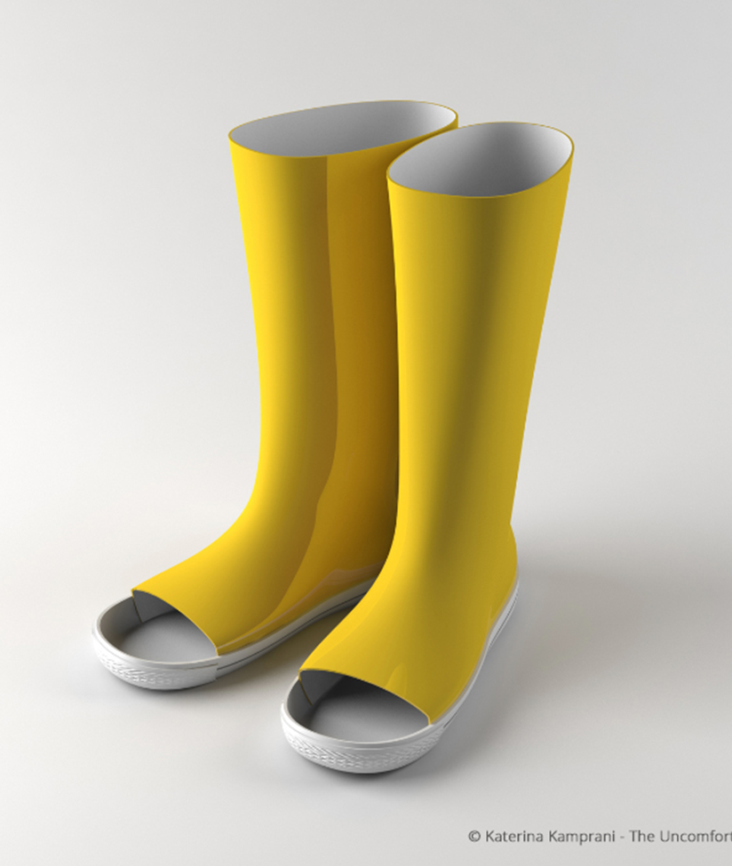
uncomfortable rain boot
Rain boots are heavy because they are made from relatively heavy, waterproof rubber or nylon. The boots are designed to keep the feet warm and dry when it rains. Boots become uncomfortable sometimes because their weight makes them slide off the legs with every step.

Slide 3
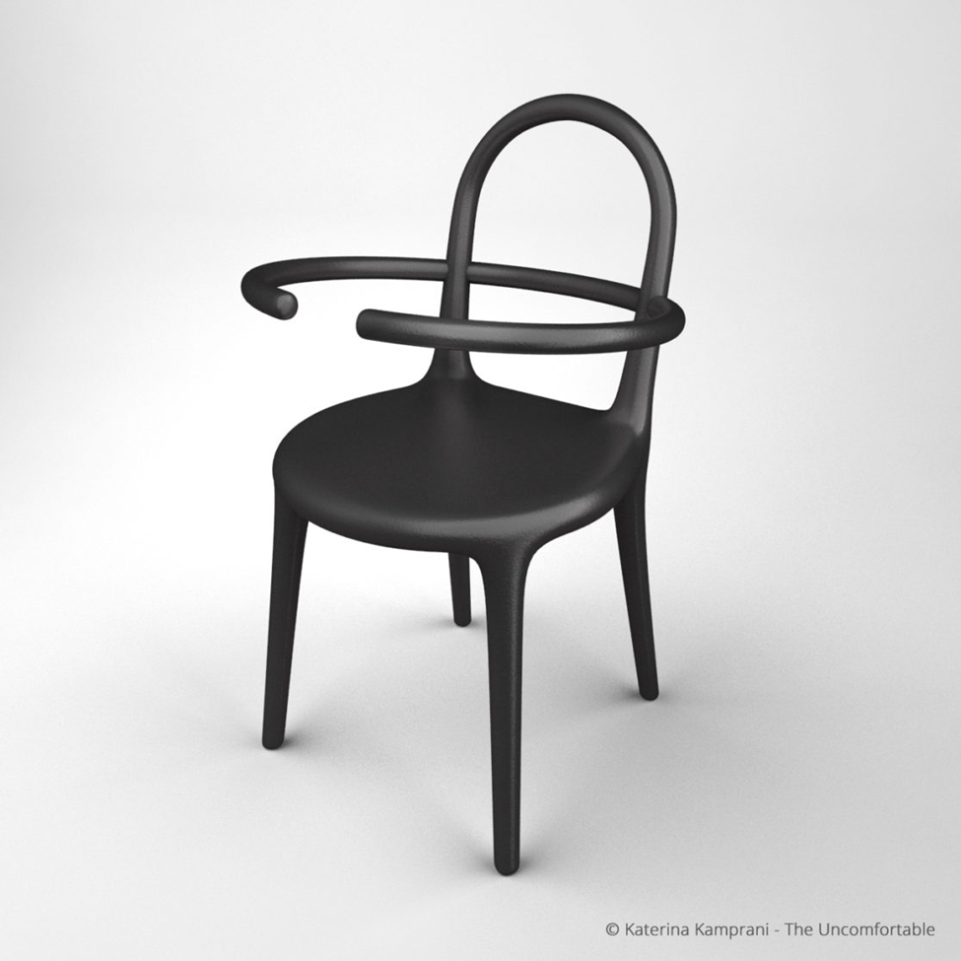
Uncomfortable hoop chair
No one can not sit on this chair

Slide 4
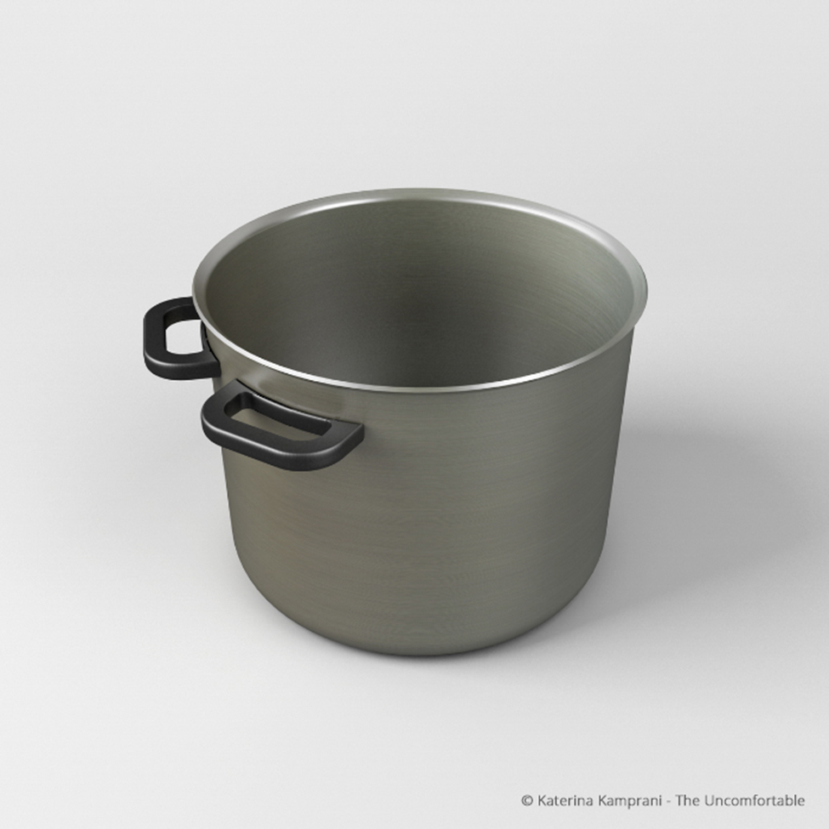
Uncomfortable pot
This pot is very uncomfortable. The food here can not lifted properly during cooking.

Slide 5
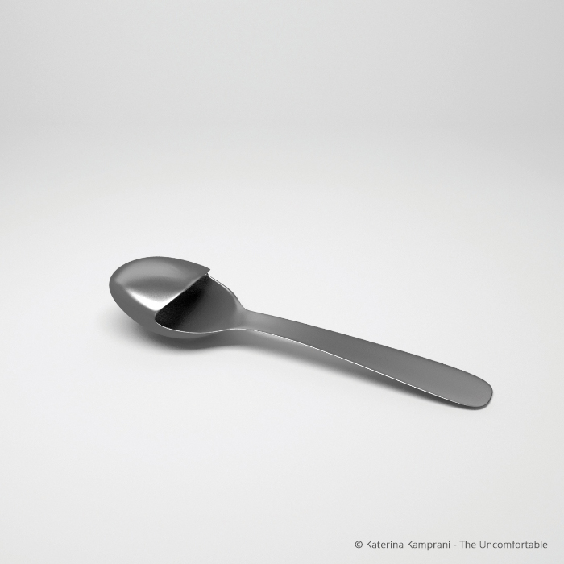
Unfomfortable slipper spoon
This spoon is unusable item.

Slide 6
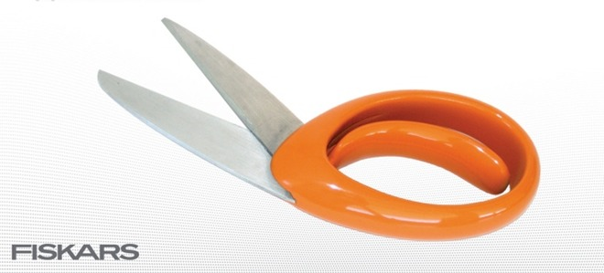
Uncomfortable scissors
The principle utilization of scissors is to cut something​ for that, its two arms ought to operate​ in this plan it can't work the scissors ​ making it unusable​.

